Slide 1



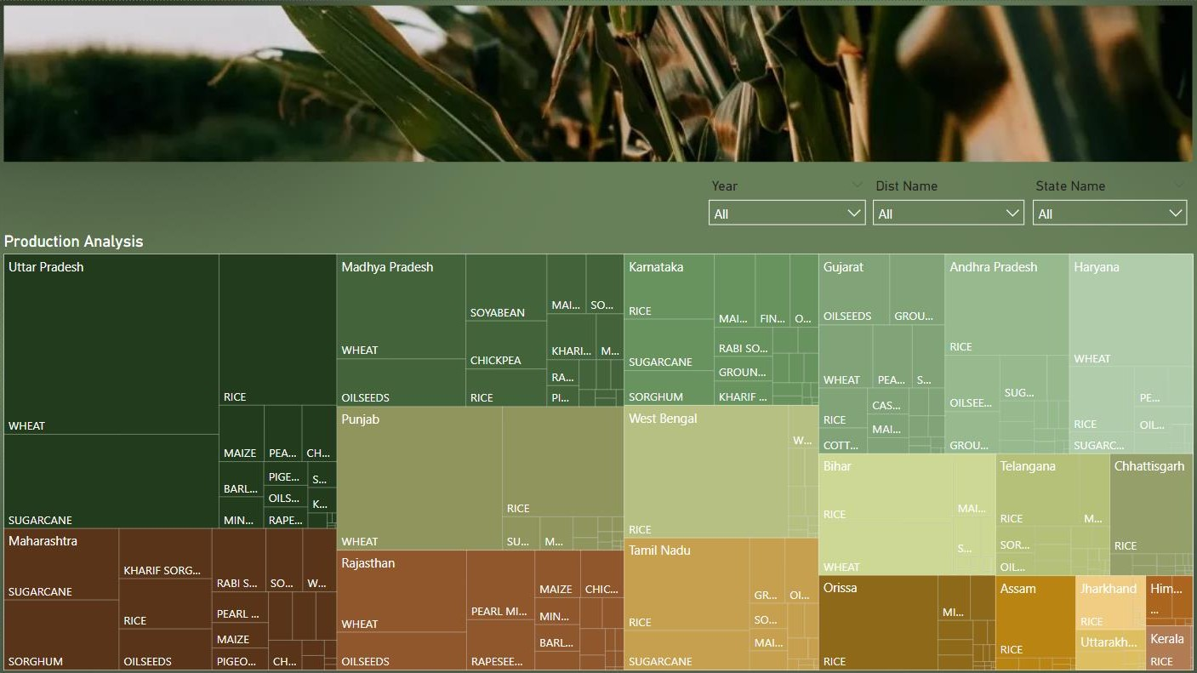
Indian Agriculture
in this dashboard, you will see Production Analysis according to different state of India.

Slide 2


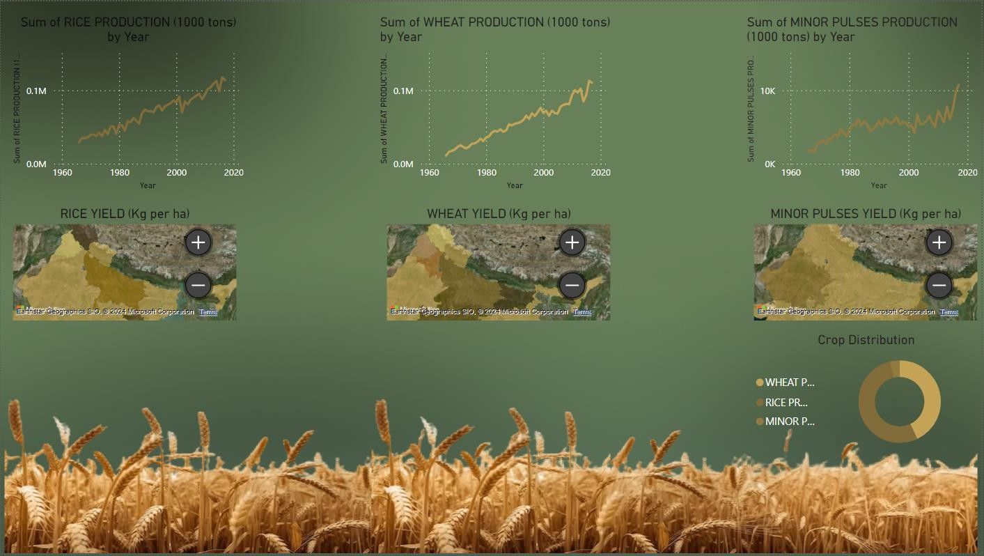
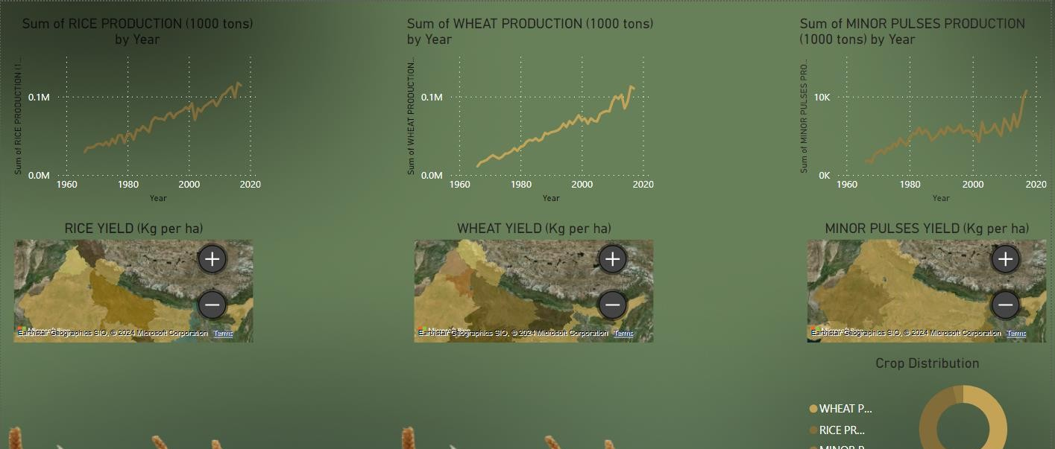
In this dashboard, you will see Crop Specific according to different state of India like WHEAT, RICE, MINOR PULSES Production and Yield.

Slide 3


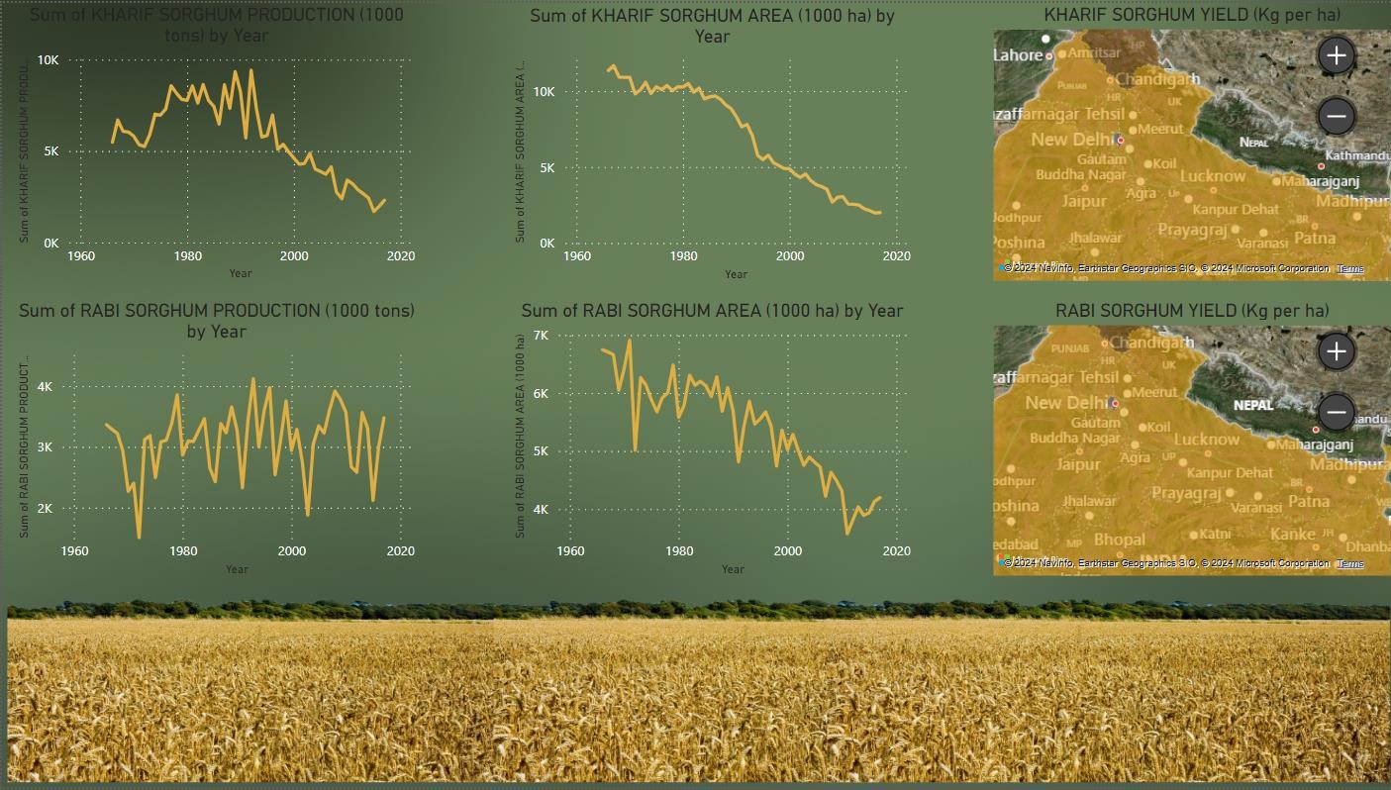
In this dashboard, you will see Seasonal Crop according to different state of India like KHARIF SORGHUM AREA and RABI SORGHUM YIELD by Year.

Slide 4


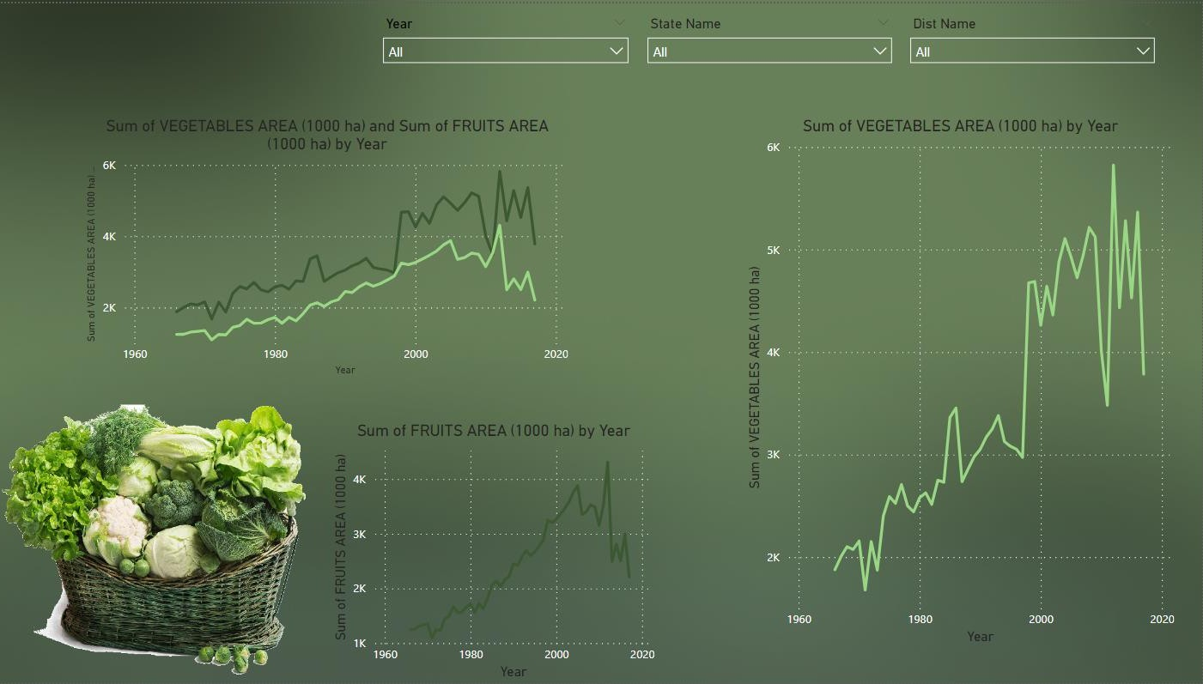
In this dashboard, you will see Fruits and Vegetables Analysis according to different state of India by Year.

